Slide 1




Order Management System for Multi-Brand Kitchen Center
Hệ thống quản lý đơn hàng cho mô hình bếp chung đa thương hiệu
Project Code: FA23SE021
Capstone Project
Lecturers:
Mrs. Nguyễn Thị Cẩm Hương
Mr. Lâm Hữu Khánh Phương
Members:
Thái Quốc Toàn - Leader
Trần Phú Sơn
Lê Xuân Bách
Võ Vỹ Khang
Lê Hồng Thành
Group Code: GFA23SE12
Capstone Project Fall 2023

Slide 2





01
INTRODUCTION
02
PROBLEMS & SOLUTIONS
03
SYSTEM OVERVIEW & TECHNOLOGIES
04
DEMONSTRATION
05
ACHIEVEMENTS & LIMITATIONS
TABLE OF CONTENT
06
Q&A

Slide 3

1. INTRODUCTION
1

Slide 4

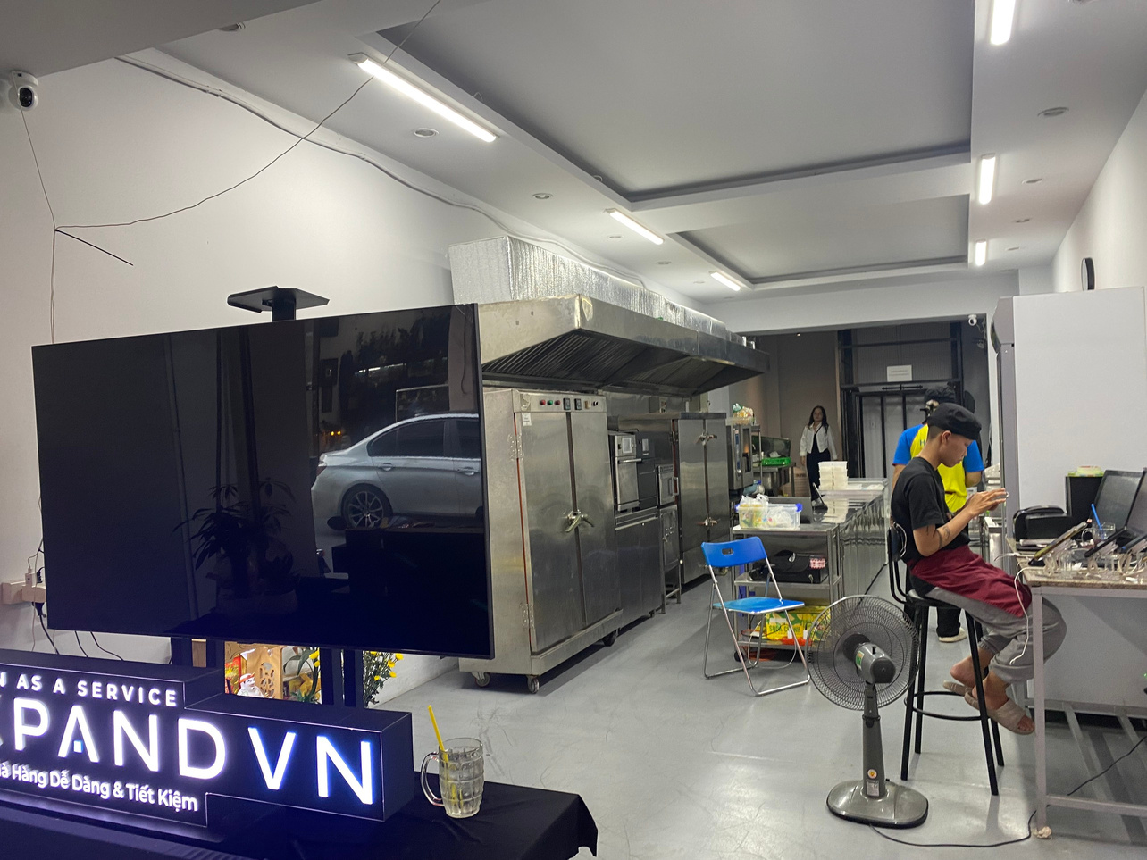
1. INTRODUCTION
A multi-brand kitchen center model is a kitchen center model where the kitchen space is used by many brands. This kitchen center model is just a place to carry out processing of brands.
Currently, in Vietnam, the need for online business on e-commerce sites is becoming a trend and is being used by many businesses in the culinary field to assist grow revenue.
Therefore, the order management on each the e-commerce system is being done separately, with no consistency in the process of receiving orders from customers.
Multi-Brand Kitchen Center
2

Slide 5
2. PROBLEMS
& SOLUTIONS
3

Slide 6
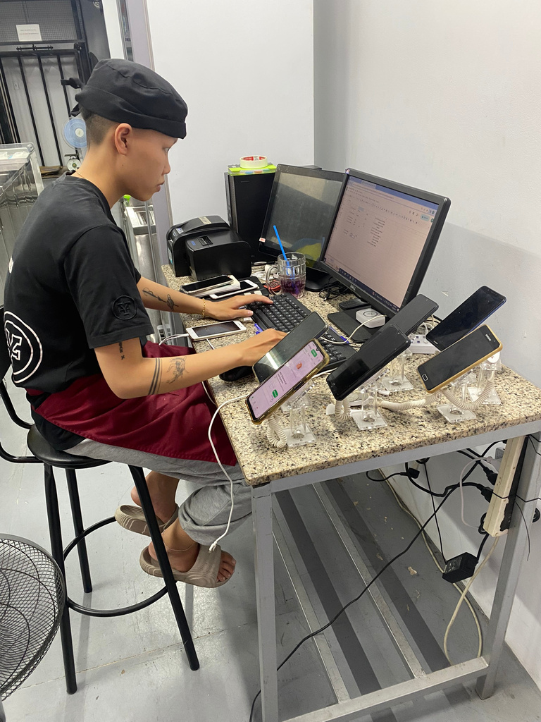
2.1 PROBLEMS
Problem 1:
Brands that are using multiple e-commerce systems are not consistent in their order management process.
Problem 2:
Receiving orders and entering employee order data in the current kitchen center model is currently done manually.
Order management
4

Slide 7
2.2 SOLUTIONS
Solution 1:
The MBKC system will make connections to the e-commerce systems that brands have provided to the MBKC system so that the MBKC system can collect orders and manage those orders on the MBKC system.
Solution 2:
The MBKC system uses MBKC Bot (worker service), which replaces data entry staff in the current kitchen center model to automatically collect orders and create new orders to the MBKC system. It will help reduce working time, increase work efficiency, and reduce personnel costs compared to the current manual method.
5

Slide 8
3. SYSTEM OVERVIEW
6

Slide 9
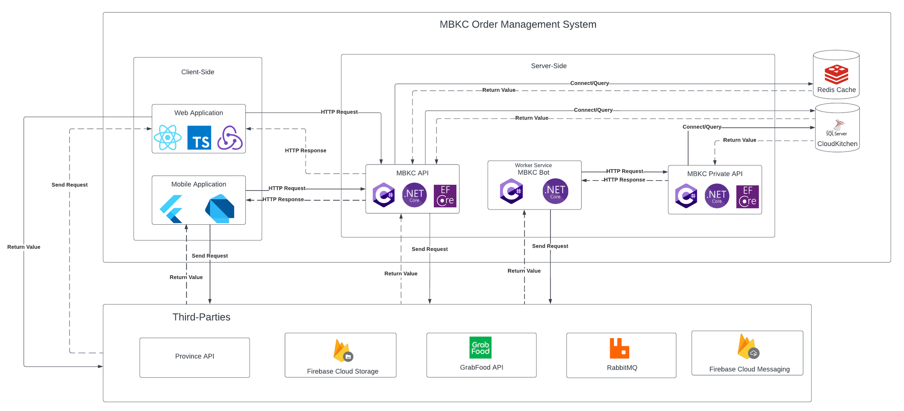
3.1. SYSTEM OVERVIEW
7

Slide 10








3.2. TECHNOLOGIES
Front-End
Back-End
Database, Cache
8

Slide 11




3.2. TECHNOLOGIES
Third-Parties
Province API
9

Slide 12
4. DEMONSTRATION
10

Slide 13




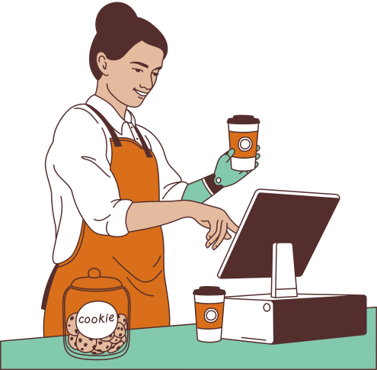




MBKC ACTORS
MBKC ADMIN
BRAND MANAGER
KITCHEN CENTER MANAGER
CASHIER
Web app
Web app
Web app
Web app
ACTORS
STORE MANAGER
MBKC BOT
Mobile app
11

Slide 14

MAIN FLOWS
1
Create Store partner and Partner Product
2
Getting, Parsing, and Confirm Orders from Partners
3
Transferring and Withdrawing Money from a Wallet
12

Slide 15
MAIN FLOWS
1
Create Store partner and Partner Product
2
Getting, Parsing, and Confirm Orders from Partners
3
Transferring and Withdrawing Money from a Wallet
13

Slide 16


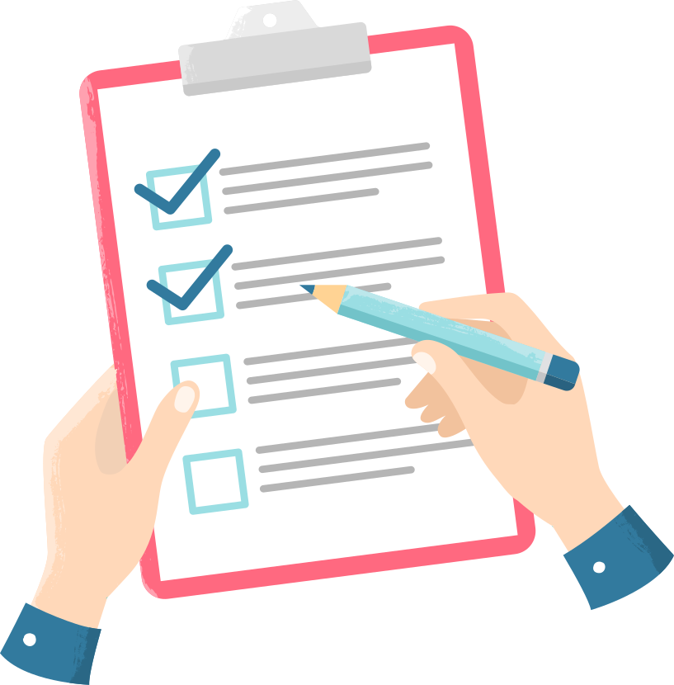



Flow 1: Create Store Partner and Partner Product
1.Fill new store partner information
2.Create Store Partner
PARTNER
BRAND MANAGER
STORE
3.Fill new partner product information
4.Create Partner Product
PARTNER
BRAND MANAGER
PRODUCT
14

Slide 17
MAIN FLOWS
1
Create Store partner and Partner Product
2
Getting, Parsing, and Confirm Orders from Partners
3
Transferring and Withdrawing Money from a Wallet
15

Slide 18
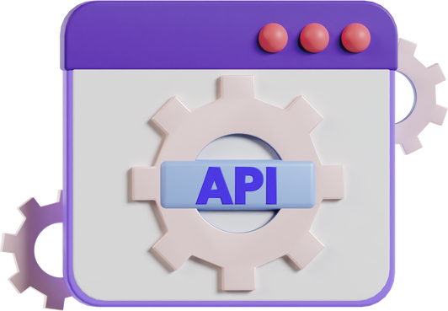

Flow 2: Getting, Parsing, and Confirm Orders from Partners
1.Get store information
2. Return store information
MBKC BOT
MBKC Private API
MBKC BOT
3. Get order from partner of store
5. Parse
orders data
4. Return
orders data
MBKC BOT
PARTNER
16

Slide 19

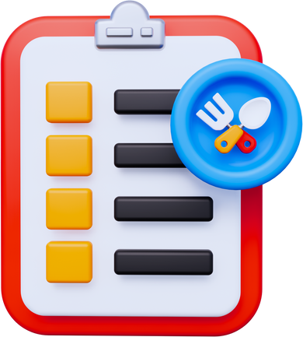



Flow 2: Getting, Parsing, and Confirm Orders from Partners
1.Call API
2.Create order
MBKC BOT
MBKC PRIVATE API
ORDER
4.Confirm finished preparing order
3.Select order
ORDER
STORE MANAGER
ORDER READY
6.Confirm order ready delivery
5.Select order
ORDER
ORDER READY
DELIVERY
CASHIER
17

Slide 20
MAIN FLOWS
1
Create Store partner and Partner Product
2
Getting, Parsing, and Confirm Orders from Partners
3
Transferring and Withdrawing Money from a Wallet
18

Slide 21


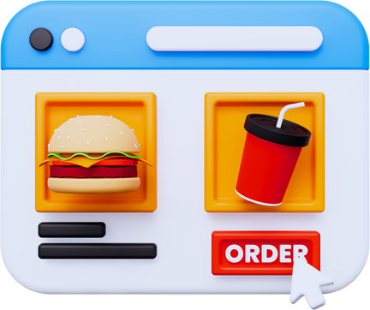
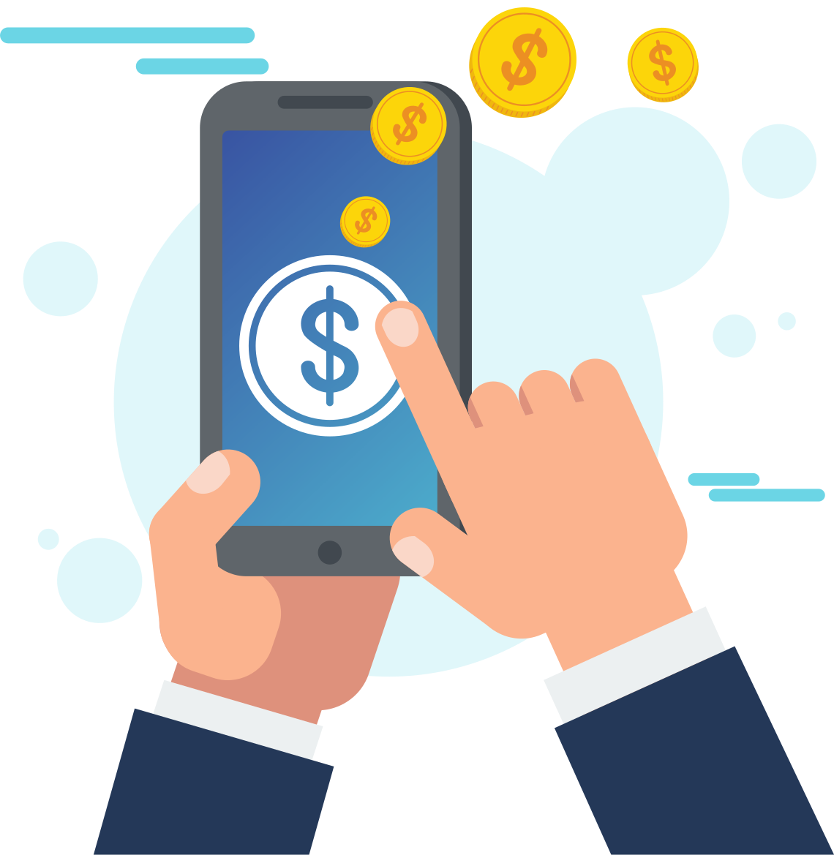



Flow 3: Transferring and Withdrawing Money from a Wallet
1.Select order
2.Create shipper payment
CASHIER
ORDER
4.Create transferring money
3.Check Wallet
TRANSACTION
CASHIER
CASHIER WALLET
CASHIER
5.Check balance
6.Create withdrawing money
KITCHEN CENTER MANAGER
KITCHEN CENTER MANAGER
KITCHEN CENTER WALLET
WITHDRAW
19

Slide 22
5. ACHIEVEMENTS & LIMITATIONS
20

Slide 23
The MBKC system has been connected to the GrabFood partner
The MBKC system has mapped products and received orders from the GrabFood system
5.1 ACHIEVEMENTS
The MBKC Bot's data collection time can be adjusted according to the configuration time.
Cash flow management is automatic.
21

Slide 24
The MBKC system is currently unable to connect to several e-commerce services. Currently, the system can only connect to GrabFood.
5.2 LIMITATIONS
GrabFood has only granted the MBKC system a few APIs, such as Login and Getting Menu. GrabFood has secured all of the remaining APIs.
22

Slide 25
6. Q&A
23

Slide 26

THANK YOU
FOR LISTENING
Capstone Project Fall 2023

